Slide 2
INTERNET NUMBER RESOURCES PLANNING
GAMCHIX SERIES SESSION 2
FEB 2018

Slide 3
TOPIC
IPv4 with Intro to IPv6
A brief History
How IP Addresses are Allocated from ICANN (IANA) to Regional Internet Registries and to Local Internet Registries?
IPv4 Public vs Private Addresses
Reserved IPv4 Addresses
Subnetting and planning an IPv4 Network
Default Subnet Masks and custom subnet Masks
The NAT process
Introduction to IPv6

Slide 4
INTERNET NUMBERS? WHAT?
As computers run on Binary Digits (bits), So all electronic transmission across the global Network.
Each Device or Network require a unique identity.
This comes alongside other names and numbering systems that make the Internet operate on globally agreed Standards:
IP Addresses: All versions
Autonomous System Numbers (ASNs)
Domain Names: Generic, ccTLDs..
Port Numbers: Well known, private …
Other Protocol Parameters

Slide 5
What is an IP Address?

Slide 6
A BRIEF HISTORY - TIMELINE
0 IP March 1977 version (deprecated)
1 IP January 1978 version (deprecated)
2 IP February 1978 version A (deprecated)
3 IP February 1978 version B (deprecated)
4 IPv4 September 1981 version (current widespread)
5 ST Stream Transport (not a new IP, little use)
6 IPv6 December 1998 version (formerly SIP, SIPP)
7 CATNIP IPng evaluation (formerly TP/IX; deprecated)
8 Pip IPng evaluation (deprecated)
9 TUBA IPng evaluation (deprecated)
10-15 unassigned
Notes:
IPv4 and ST were both specified in the late 1970’s. ST was a complementary protocol to IP, providing a connection-oriented internetwork service that was used to support early experiments in Internet audio/video teleconferencing.
SIP[P], CATNIP, Pip, and TUBA were the four candidates considered in the early 1990’s by the IETF for the new IP. SIPP was the “winner”, after it was changed from having 64-bit addresses to 128-bit addresses.
SIP = Simple Internet Protocol
SIPP = Simple Internet Protocol Plus
CATNIP = Common Address Technology for Next-Generation IP
Pip = Paul’s IP?
TUBA = TCP and UDP with Bigger Addresses
(aka CLNP, the OSI Connectionless Network Layer Protocol)

Slide 7
A BRIEF HISTORY CONT..
IPv4 as the standardized protocol was invented in the 1970s as the first major version of internet protocol..
It was first introduced to the public in 1981, then became the foundation of the Internet and many other enterprise networks worldwide.
Only 3.7 billion IPv4 addresses are usable by ordinary Internet access devices. The others are used for special purpose, like IP Multicasting.
Almost three and a half billion addresses was enough for the experiment that the Internet started as in the 1980s, but it proved not not enough for the global network in today’s world, with its population of over seven billion people.
So new versions were proposed at the IETF

Slide 8
what ever happened: IPv5 or IPv6 ?
So, Of course there was a protocol proposed as IPv5 (the ST), along those years with special purpose ie Internet Streaming.
The Internet Stream Protocol -- was created for the experimental transmission of voice, video, and distributed simulation. Two decades later, this protocol was revised to become ST2 and started to get implemented into commercial projects by groups like IBM, NeXT, Apple, and Sun.
The Standard now only got some of its features in other protocols like MPLS
In the early 90s, around IETF 26, it was agreed IPv6 be the future.

Slide 9
IP DISTRIBUTION AND REGULATION

Slide 10
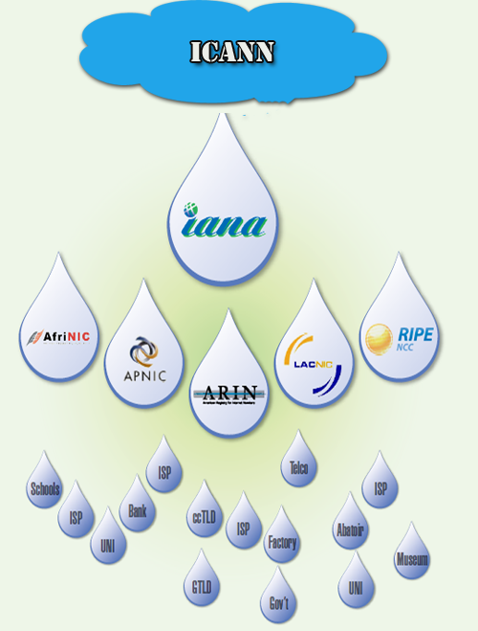
IP ADDRESS DISTRIBUTION

Slide 11
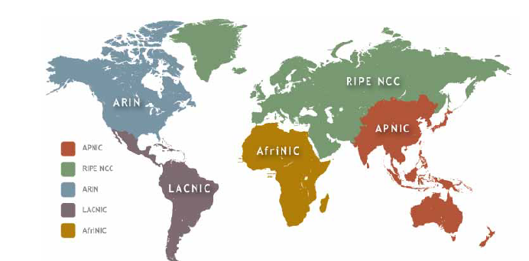
Regional Internet Registries (RIRs) round the world

Slide 12
HOW WERE IP ADDRESSES DISTRIBUTED
IANA assigns addresses based on globally agreed-upon rules, or policies. The key policy elements for IPv4 were:
RIRs received IPv4 blocks in /8 units from IANA.
RIRs could receive an additional block when they had just one half of a block left.
The number of /8 units RIRs received was based on a formula established by IANA.

Slide 13
HOW ADDRESSES WERE DISTRIBUTED?
Two policies governed the allocation of IPv4 addresses to the RIRs:
The regular policy was called the Policy
for Allocation of IPv4 Blocks to Regional Internet Registries and governed how IPv4 addresses were allocated to RIRs since April 2005.
The second, called the Global Policy for the Allocation of the Remaining IPv4 Address Space, governed how the last five IPv4 /8s were allocated. It was ratified in March 2009

Slide 14
Who sets these Policies?
These distribution policies are developed in the RIRs’ regional public policy forums. Like Afrinic PDP meetings held during AIS. https://www.internetsummit.africa
The process is very similar to the consensus-based, bottom-up approach used to develop other ICANN policies.
The RIRs allocate addresses to ISPs and other network operators according to the policies developed in these public policy forums, in which representatives from industry, governments, and civil societies participate.
Anyone can submit a global policy proposal. The proposal can be submitted to an individual RIR’s policy-making process, like any other regional policy proposal, or they can be submitted directly to the
Address Supporting Organization Address Council (ASO AC).
https://aso.icann.org/

Slide 15
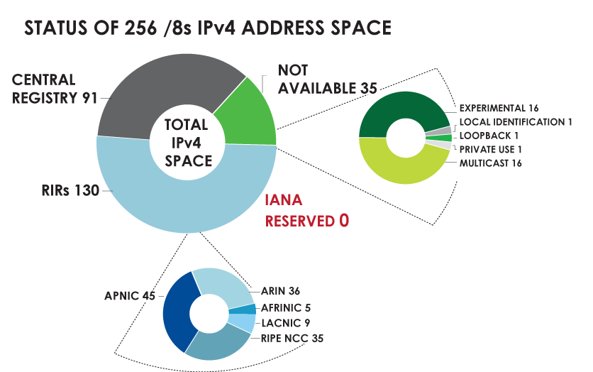
IPv4 ADDRESS SPACE What is the status of each of the 256 /8s?

Slide 16
Available IPv4 /8s In Each RIR

Slide 17
Lets do some little statistics
IPv4 ADDRESS SPACE ISSUED (RIRs TO CUSTOMERS) In terms of /8s, how much total space has each RIR issued? (Jan 1999 – Dec 2017

Slide 18
INTERNET PROTOCOL VERSION 4 (IPv4)
THE BASICS

Slide 19
IP Address Classes
IPv4 addresses were divided into 5 classes, each of which is designated with the alphabetic letters A to E.
Class D addresses are used for multicasting.
Class E addresses are reserved for testing & Research and some mysterious future use ☺

Slide 20
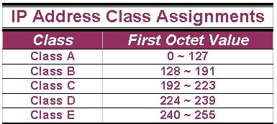
IP Address Classes (Cont.)
The 5 IP classes are split up based on the value in the 1st octet:

Slide 21
RESERVED IPS
127.0.0.1 = Loopback testing
169.254.0.0 – 169.254.255.255 = APIPA, Link Local
CLASS D ADDRESSES = 224 ~ 239
Multicasting
CLASS E ADDRESSES = 240 ~ 255
Research and Military experiment

Slide 22
PUBLIC vs PRIVATE ADDRESSES. RFC 1918?
To explore IPv4 Public vs Private, lets looks at what RFC 1918 says:
10.0.0.0 - 10.255.255.255 (10/8 prefix) = private
172.16.0.0 - 172.31.255.255 (172.16/12 prefix)
192.168.0.0 - 192.168.255.255 (192.168/16 prefix)

Slide 23
PUBLIC vs PRIVATE IPs

Slide 24
PUBLIC vs PRIVATE
SAMPLE PUBLIC IPs: 201.1.102.2, 192.200.1.4, 120.15.19.1, 9.100.1.4, 100.50.192.1, 170.80.19.9
SAMPLE PRIVATE IPs: 192.168.1.1, 192.168.100.200, 172.16.4.1, 172.17.20.19,
10.100.19.8, 10.10.1.1, 10.1.2.1,

Slide 25
Are You the Host or the Network?
The 32 bits of the IPv4 address are divided into Network & Host portions, with the octets assigned as a part of one (either the Network portion) or the other (host portion)
Network & Host Representation
By IP Address Class
Class
Octet1
Octet2
Octet3
Octet4
Class A
Network
Host
Host
Host
Class B
Network
Network
Host
Host
Class C
Network
Network
Network
Host

Slide 26
Addressing Hosts
Given the 172.16.0.0 address with the 255.255.0.0 subnet mask:
Network
Network
Host
Host
172
16
0
0
One network address, 65,534 hosts, one broadcast address.
172
16
0
0
1 Network Address
172
16
0
1
Host Addresses
2¹⁶ – 2 = 65,534
172
16
Etc.
Etc.
172
16
255
254
1 Broadcast Address
172
16
255
255

Slide 27
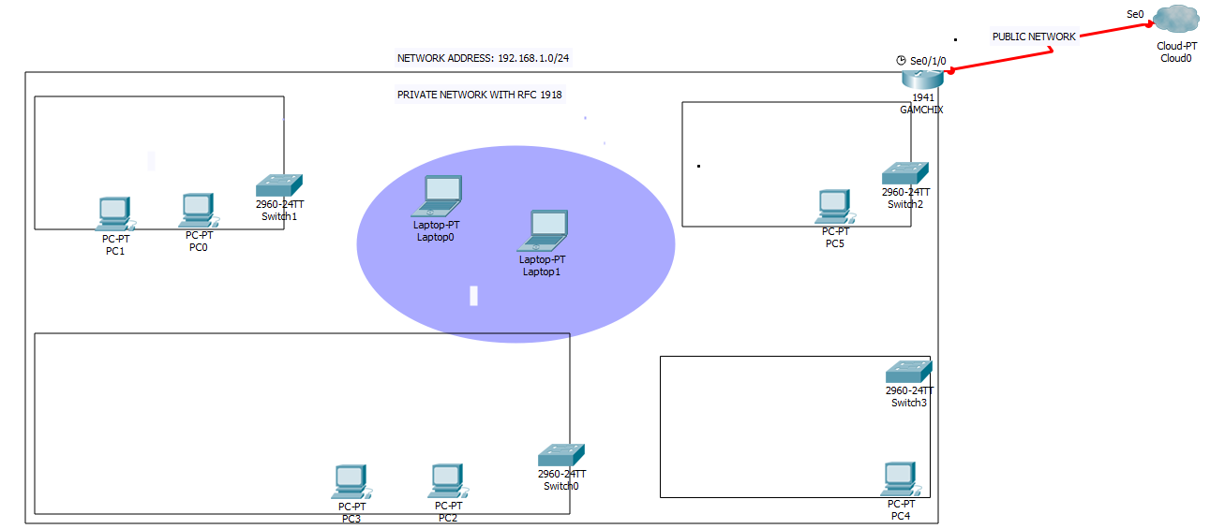
SAMPLE NETWORK PLAN
NAT
Public IP = 196.10.10.2
SUBNET 1
VLAN 40
Accounts Dept.
SUBNET 1
VLAN 10
IT Dept.
This shows how the
Private IP range (RFC 1918)
is used to cater for local
Network (LAN) addressing
needs for the overall local network.
The public IP resides on the
external link connecting the local
network to the ISP cloud.
All private IPs will share the one public IP by NAT
SUBNET
VLAN 50
Wireless.
SUBNET 1
VLAN 30
Accounts Dept.
SUBNET 2
VLAN 20
Admin Dept.

Slide 28
Range of hosts – Your Turn!
Network Address Subnet Mask Broadcast Address
172.0.0.0 255.0.0.0 172.255.255.255
172.0.0.1 to }
172.255.255.254 }
172.16.0.0 255.255.0.0 172.16.255.255
172.16.0.1 to
172.16.255.254
192.168.1.0 255.255.255.0 192.168.1.255
192.168.1.1 to
192.168.1.254
192.168.0.0 255.255.0.0 192.168.255.255
192.168.0.1 to
192.168.255.254
192.168.0.0 255.255.255.0 192.168.0.255
192.168.0.1 to

Slide 29
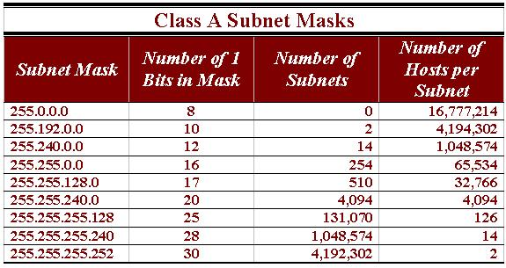
Class A Subnet Masks
A sample of subnet mask options available for Class A addresses.

Slide 30
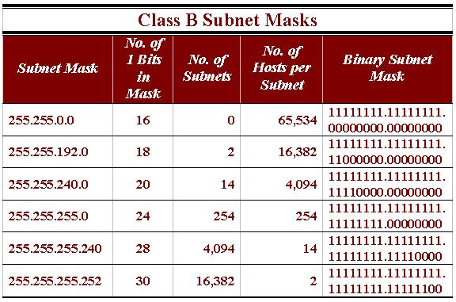
Subnetting Class B
A sample of the subnet masks available for Class B networks.

Slide 31
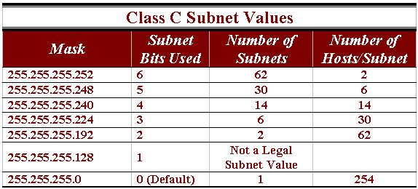
Class C Subnets
Knowing the relationships in this table will significantly reduce the time you spend calculating subnetting problems.

Slide 32
INTRODUCING IPv6
THE NEXT GENERATION PROTOCOL

Slide 33
IP Next Generation Protocol
IPv6
Greatly expanded
address space (2¹²⁸)
More attractive for
future Internet applications
compared to IPv4
Potential socio-economic
benefits for
ubiquity of the Internet ;
Multi Access:
Enhanced life mobility
Notes:
IPv6 is one of the useful delivery protocols for the future fixed and wireless/mobile network environments.
The necessity of IPv6 protocol will be more and more increasing for the NGN.

Slide 34
Introducing IPv6
Increased address space
Improved packet handling
Eliminates the need for NAT
Integrated security
IPv4 has only ~ 4 billion IPv4 addresses 4,000,000,000
This means 2^32
IPv6 has up to: 340 undecillion IPv6 addresses 340,000,000,000,000,000,000,000,000,000,000,000,000
This means 2^128
Notes:
6.1.4.2 Introducing IPv6

Slide 36
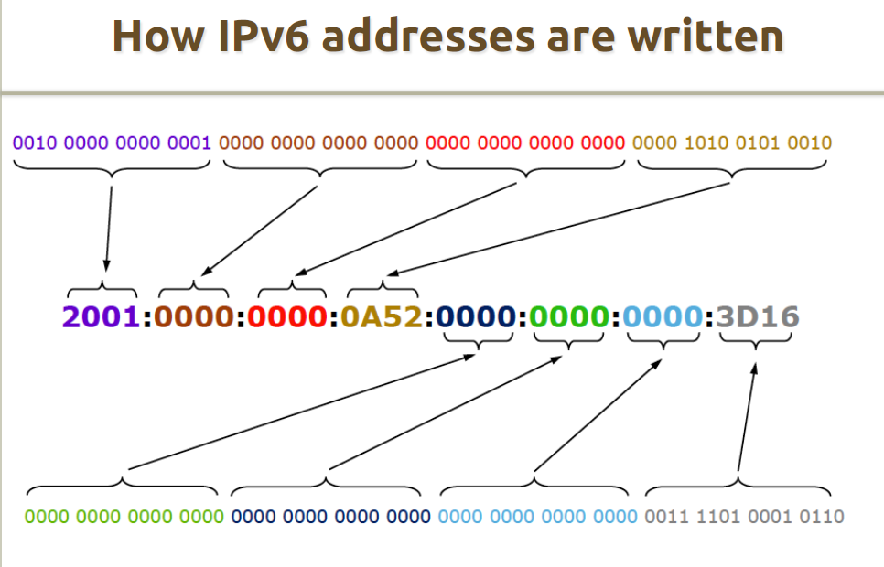

Slide 40
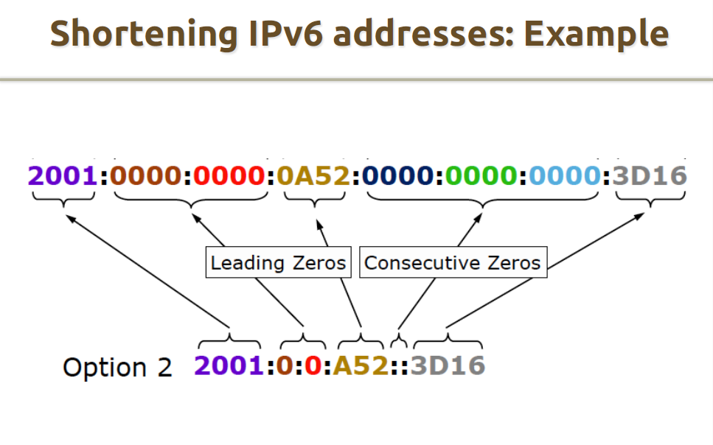

Slide 42
To be continued… IP ADDRESSING PART 2

